Slide 1





May 11
GOODHack24
Unstoppable
Team Members: Mick, Dhairya, Rita

Slide 2


Our Team

Slide 3
Ideation Process
Goal
Incorporation of open data inspiring action to address local heat inequity
Waterloo Organizations
Green House
Climate Action Waterloo Region
Existing Solutions
Kitchener GeoHubs

Slide 4
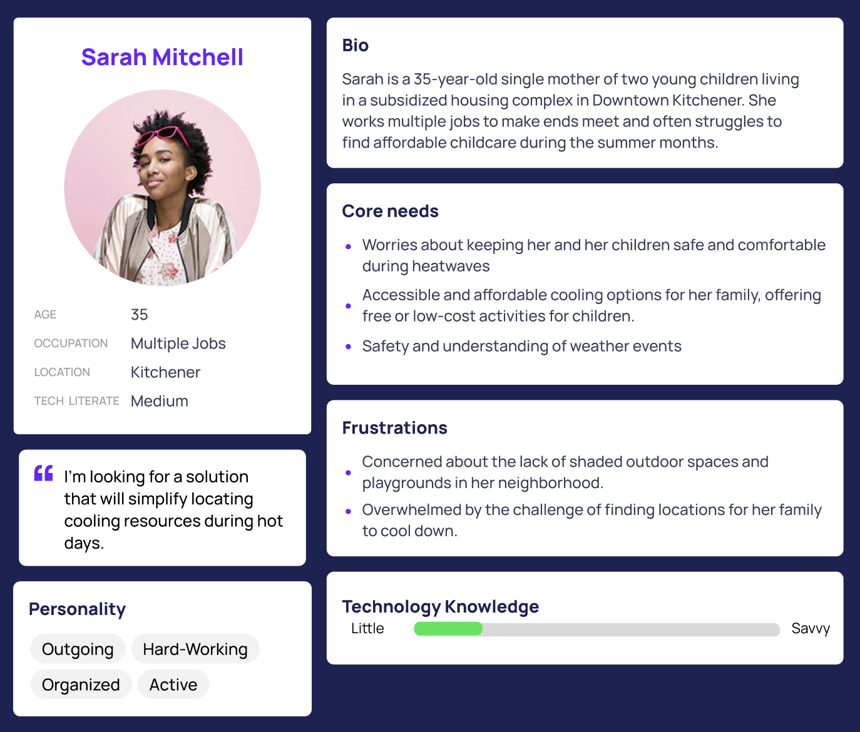
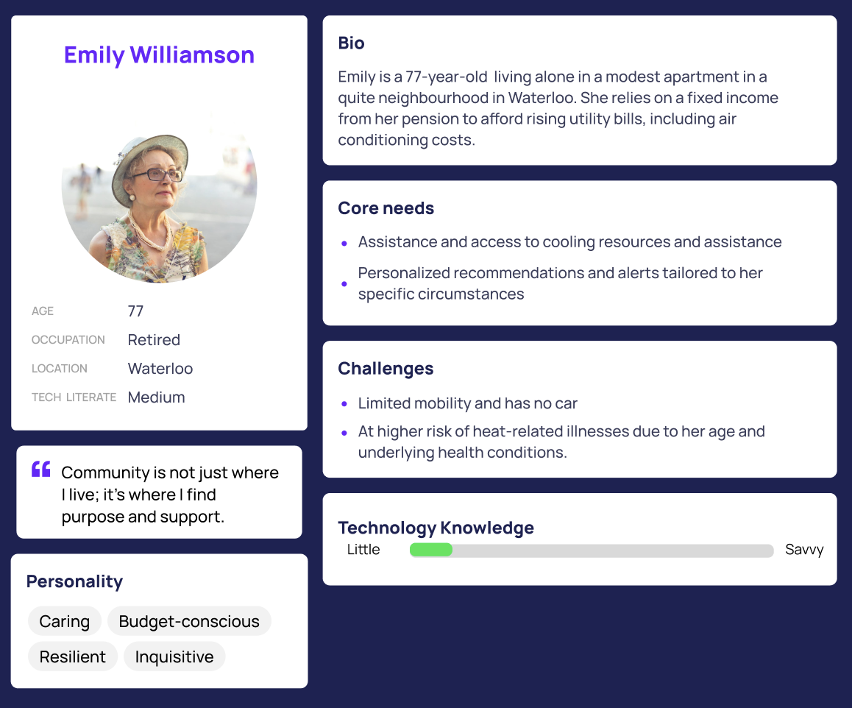
Diverse User Personas
Business Travelers
Family Travelers
Focused on efficiency
Emphasize budget, educational activities, and flexibility for family members
Notes:
Resources:
Free application, no funding needed just advertisement They provide a good framework to help generate ideas and solutions based on narrative scenarios.
Personas allow us designers to better understand the diversity of target groups.
Target user
Low-income households
Elderly individuals
People with health conditions, and others who may lack access to resources and support to cope with extreme heat events
Assumptions/ Shortcomings
Nearby cooling stations are accessible to all residents
Assess the geographical distribution, capacity, and affordability of cooling centers and resources within the target urban area. Identify any disparities or barriers to access, such as transportation limitations, financial constraints, or language barriers, and explore strategies to address these inequities.

Slide 5



Challenges and Expectations
Increasing Heat Stress
11%-18% increase in the number of days with high humidity and temperature exceeding 30°C and over
Lack of awareness
Shortage of advertisement for individuals to effectively navigate and mitigate high temperatures
Health and Economic Impacts
Increased illnesses and deaths, economic losses and decreased air quality

Slide 6

Initial Solution: The Embodiment of Ideas
User-Friedly
Accessible Approach
Easy user interaction and intuitive navigation
Optimizing data delivery to users
Innovative
Simple
Original and creative solution
Simple application implementation with open data
Notes:
User friendly and innovative solution that can be easily accessed through a mobile phone in a form of an application. Because this is an application, this is an accessible approach, optimizing data delively to users. Finally, this is the best solution since it is simple to design and navigate.
OR
An accessible, user-friendly, and innovative mobile application solution facilitates easy access and efficient data delivery to users. Its simplicity in design and navigation makes it the optimal choice.

Slide 7


Slide 8
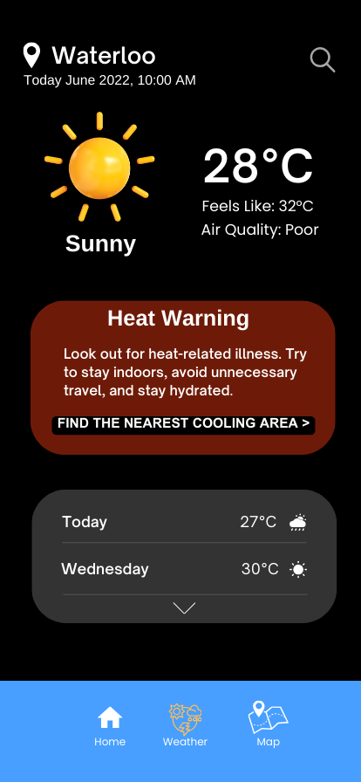
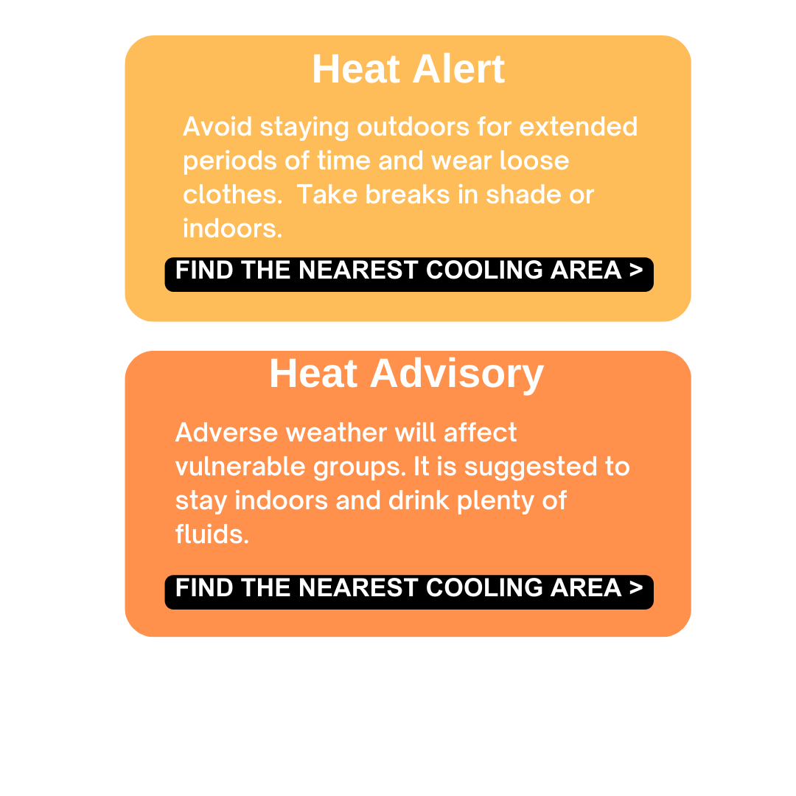
Notes:
Google Maps
Weather notifications
Air Quality monitoring
Map navigation to cooling stations (ex. Building with AC, pools, and splash pads)
Hours of operation
Communication with promoting events
Community Heat Alerts: Develop a mobile or web application that provides real-time heat stress alerts to vulnerable populations based on their location. This app can offer personalized recommendations such as nearby cooling centers, hydration reminders, and tips for staying cool during extreme heat events.
Imagine the simplicity of navigating Google Maps and arriving to your destination. Similar to Google Maps, our application will feature warning (for example, heat/ weather warnings and alerts) notifying the user to be cautious when traveling in Waterloo/ Kitchener for that day. By incorporating local open data, that app will additionally navigate the user to the closest cooling centres such as buildings with AC, pools, and splash pads and show hours of operation for those cooling centres.
In-app community forums: Create a space within the app where users can connect with each other, share experiences, and exchange tips for coping with extreme heat, fostering a sense of community support and resilience.

Slide 9
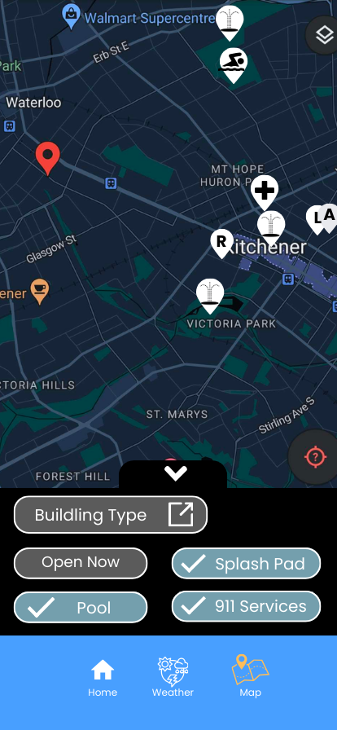
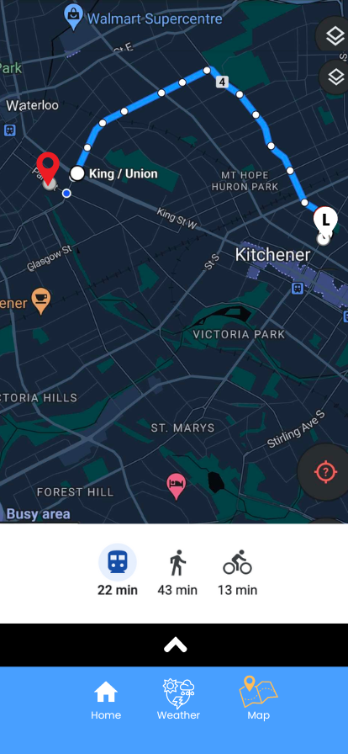
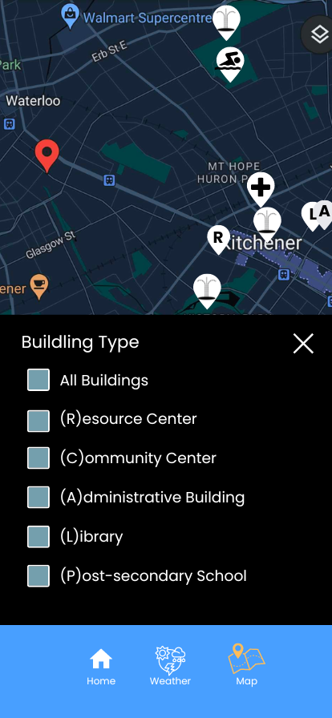
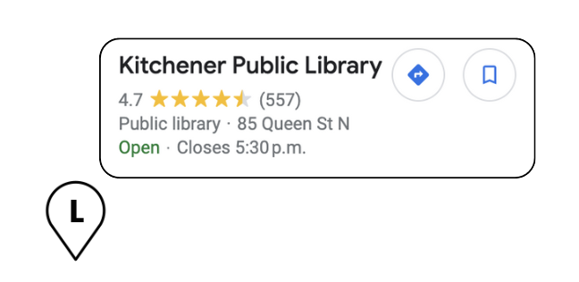

Slide 11



Future Features
Social media sharing
Language localization
Community Feedback
Notes:
Social media sharing: Enable users to share heat stress alerts and safety tips with their social networks, spreading awareness and encouraging others to stay safe during extreme heat events.
Language localization: Provide support for multiple languages to ensure accessibility for diverse communities, allowing users to receive alerts and recommendations in their preferred language.
Community feedback and reporting: Allow users to report heat-related issues such as malfunctioning cooling centers or insufficient access to hydration resources, empowering communities to advocate for improvements in heat preparedness and response measures.

Slide 12

Thank You

